Slide 1
Be A Math Major!
Or minor?

Slide 2
What you need for a Minor
Calc I
Calc II
Three more courses MAT 200 or above.
That’s it.
No, really. That’s it!

Slide 3
What you need for a Math Major
The Core
Calc I, II, III
Discrete Mathematics
Linear Algebra
CSC 115 or EGR 116
A Wing Course
Physics
Data Structures
Secondary Methods
Upper Level Courses
Real Analysis or Modern Algebra
Three other Math courses 220+ that are not in the Core
Seminar and Portfolio
Three semesters of 1-credit seminar
1-credit Math Portfolio

Slide 4
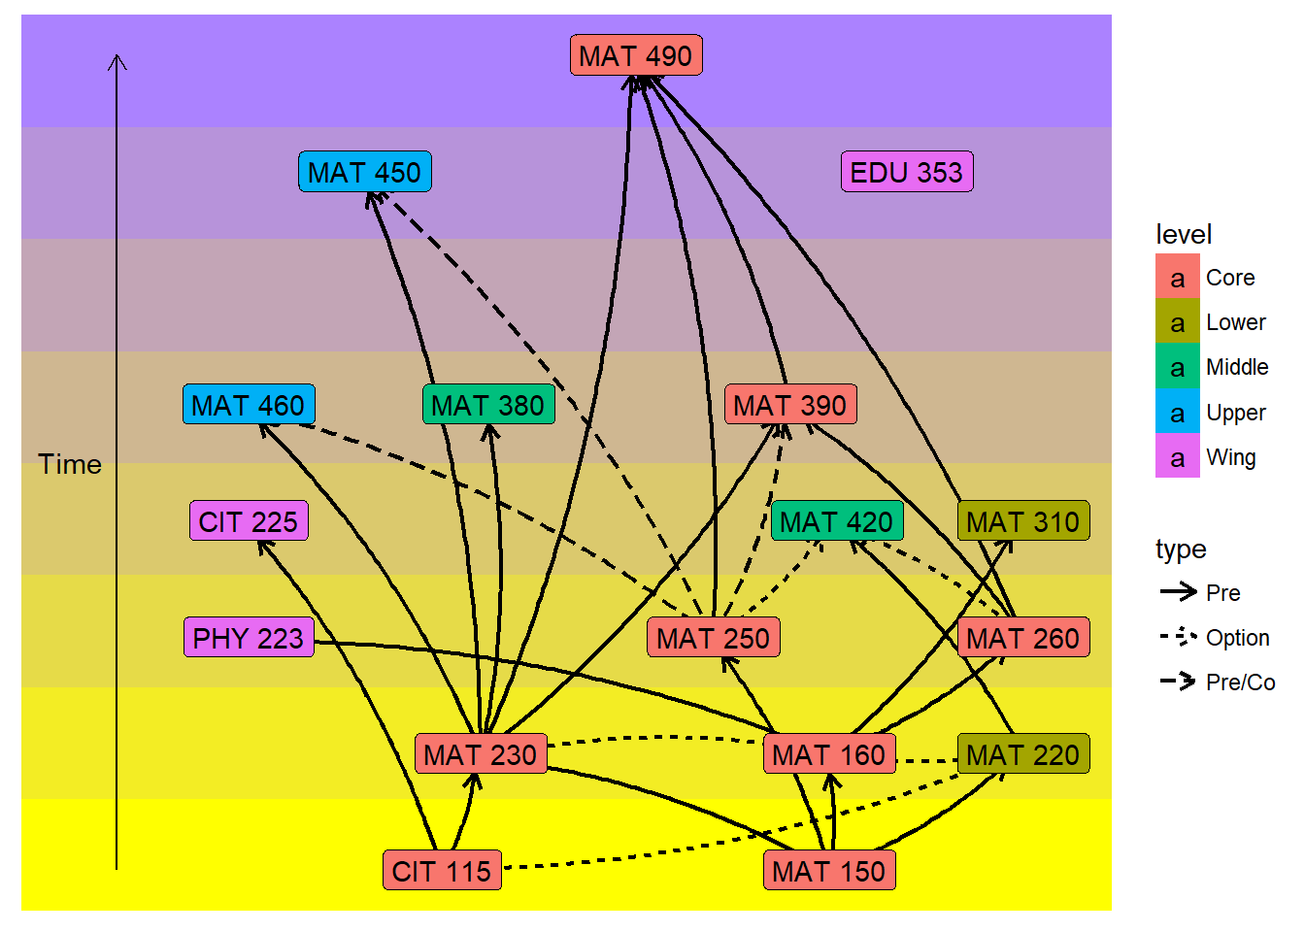

Slide 5
What can you Do with a Math Major
Anything!
What recent graduates are doing
Allie Ewald works as an Analyst at Target
Hunter Brehm is a software developer for American Trust
Heather Everding works as a data analyst at UnityPoint Health
Zach Schroeder is in Law School at Iowa studying Patent Law
Nic Rizzo coaches Women’s Soccer at Monmouth University
The Jesses (Nicole and Brandi) work in psychometry on this continent and in Europe
Katie Gonzalez works in Media Relations at Eastern Michigan University
Zach Gogel and Nicole Koetz teach in the Dubuque Public Schools
Kyle Leeson teaches in Holy Family Catholic Schools
Daniel Thole is principal at Columbus Catholic High School

Slide 6
What do you do as a Math Major
Think about fun problems
Eat tasty treats
Get to say “I am a math major.”
Impress future employers
Take Math classes and hang out with Math professors
Have space in your schedule to take other classes that sound interesting
Go to conferences to present your own work
Do Math competitions

Slide 7
Why Employers want Loras Math Majors
Problem-solving skills
Ability to abstract
Break complicated problems into solvable small pieces
Ability to learn new things on their own
Attention to detail
Think of problems in a different way
Able to communicate ideas well
Able to collaborate

Slide 8
Fun Problems for Senior Projects
Predicting March Madness
Modeling Flu
Helping nonprofits (analyze data)
Games – Set, Sudoku, Rubik’s Cube, TicTacToe
Shape Numbers in higher dimensions

Slide 9
A fun Problem
In a hockey tournament, each team played each other team once. The final table was
 | Wins | Draws | Losses | Points
Falcons | 1 | 2 | 0 | 4
Condors | 1 | 1 | 1 | 3
Eagles | 1 | 1 | 1 | 3
Hawks | 1 | 0 | 2 | 2
If Hawks’ only win was against Condors, what was the outcome of the other 5 games?

